Slide 1
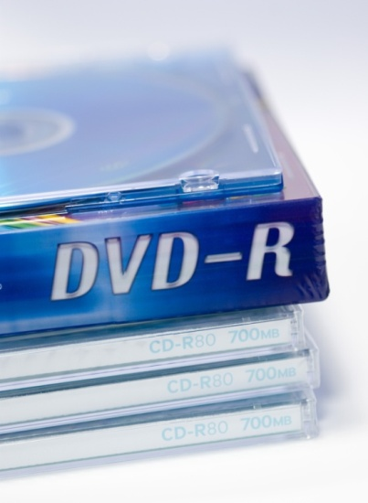
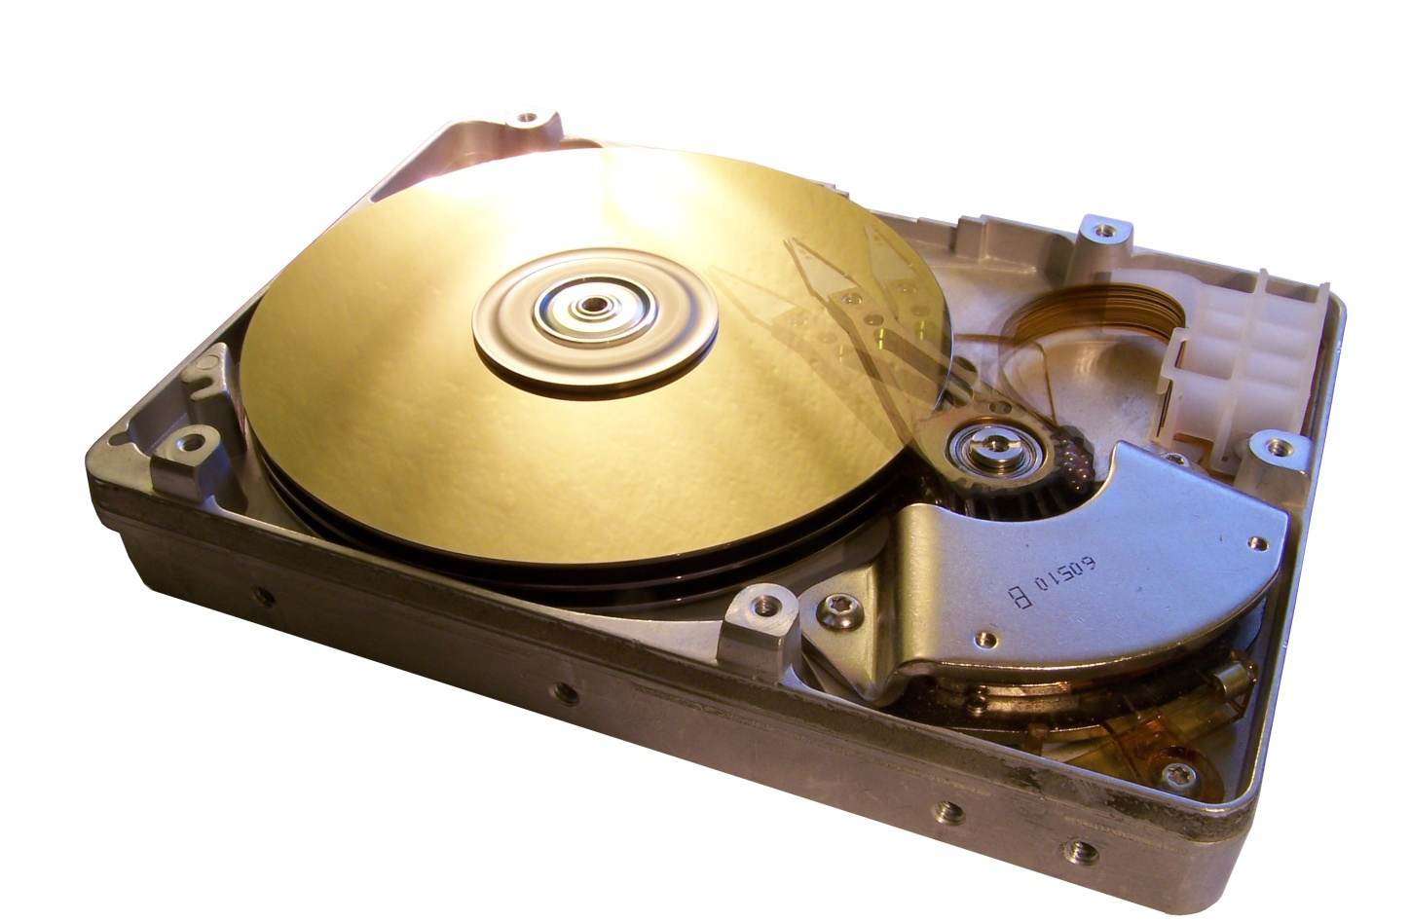
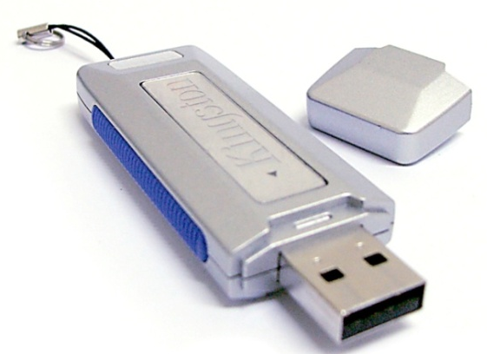
Lecture 4
Storage Devices
Notes:
Kinds of storage devices:
Magnetic devices use a magnet
Optical devices use lasers
Solid-state devices have physical switches
Media is the material storing data
Storage devices manage the media
Motivations for studying storage devices:
1. Storage devices are essential components of computers.
2. We can improve our computer’s performance through disk optimization.

Slide 2

Today’s
lecture
Lecture Outline
Hierarchy of memory/ storage devices
Magnetic storage
Optical storage
Solid-state storage
How is storage used by OS

Slide 3
Hierarchy of memory/ storage devices
Reg.
Cache
RAM
Hard Disk
Notes:
A ranking of computer memory devices, with devices having the fastest access time at the top of the hierarchy, and devices with slower access times but larger capacity and lower cost at lower levels.
The hierarchical arrangement of storage in current computer architectures is called the memory hierarchy. It is designed to take advantage of memory locality in computer programs. Each level of the hierarchy has the properties of higher bandwidth, smaller size, and lower latency than lower levels. Most modern CPUs are so fast that for most program workloads, the locality of reference of memory accesses and the efficiency of the caching and memory transfer between different levels of the hierarchy are the practical limitation on processing speed. As a result, the CPU spends much of its time idling, waiting for memory I/O to complete.
The levels of memory in a computer. From fastest to slowest speed, they are:
Processor registers – fastest possible access (usually 1 CPU cycle), only hundreds of bytes in size
Level 1 (L1) cache – often accessed in just a few cycles, usually tens of kilobytes
Level 2 (L2) cache – higher latency than L1 by 2 to 10 times, often 512 KB or more
Main memory – may take hundreds of cycles, but can be multiple gigabytes.
Secondary and Tertiary storage – several seconds latency, can be huge

Slide 4
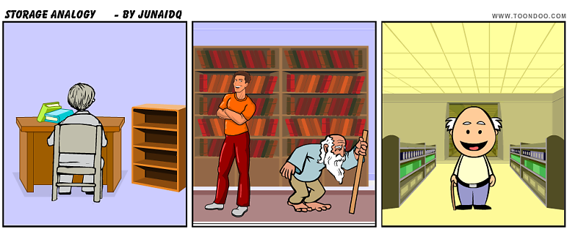

Analogy
Study table
Mr. Northbridge
Study room
Home Library
City Library
Mr. Southbridge
Student
Mr. Librarian
Study room’s file cabinet
Notes:
Analogy:
The student has a study table at home, that can keep 1 to 2 books. He has a file cabinet at a hand span's length that can store 10 books. The bigger file cabinet is kept in the home library that can store up to 100 books. The city library (5 kms away), on the other hand, has many cabinets and can store thousands of books. The student is not very intelligent in the sense that he needs to be told everything that is to be done, i.e., he needs to be given data and instructed what to do with it.
Note the hierarchical structure: 1 book on study table; 10 books on study room's file cabinet; 100 books in home library; and 1000s of books in the city library. The study room file cabinet only stores the book that the students needs at this time, or will need very soon. Due to their small size, the study table and study room's file cabinet can store a limited number of data/ instructions only. The city library acts a repository (collection) of instructions to solve problems (called programs) and data.
The student can only work (process) data/ instructions that are on his study table. The student can extend his hand to the study room's file cabinet (cache) to fetch some book/ instructions in a very short time. He has hired a very efficient assistant called Northbridge that will bring him the data/ instructions he requires from the home library (RAM) to the study room file cabinet (cache memory) and then to his study table (CPU registers) in a short time. The student prefers that most of the instructions/data are present on the study room file cabinet (cache memory) since it requires minimal waiting. If the instructions/ data are not present on the study room final cabinet, the assistant Northbridge can fetch the data from the home library in a short time. The thing the student dislikes most is that the required instruction/ data is not available even in the home library (RAM); in such a case, another assistant Southbridge (who is quite lazy and slow) has to co-ordinate with the city librarian (disk controller) to get the books delivered; this often takes a long time and the student has to sit idle all this while to his dismay.

Slide 5
Computers
Northbridge;
Memory Controller Hub (MCH)
CPU Registers
CPU
RAM
Disk storage
Southbridge;
I/O controller;
IO controller hub (ICH)
Microprocessor
Disk controller
Cache memory
Notes:
Let's now explain what the analogy meant: the student is the CPU; the study table (used to store the books temporally) is CPU registers; the file cabinet at a hand span's length is the cache memory; the file cabinet in the home library is the RAM; the file cabinet in the Library is the hard disk; the assistant to fetch documents from home library is the Northbridge chip; the assistant to fetch documents from the city library is the Southbridge chip. The CPU can only decode instructions and operate on data in the CPU registers (that is a kind of very quick memory private to the CPU). The programs/instructions stored on hard disk firstly have to be brought to RAM by Southbridge. When these instructions/data are referred to by the CPU, they are taken to the CPU registers and are stored in the cache en-route in case the data/instructions are referred to again---in such a case, the request would be fulfilled by the cache itself and the data would not have to brought from RAM.
It's obvious that if the student has to perform efficiently, most of the data should be in the study room file cabinet (cache memory).
Caching usually adopts two approaches to ensure that requested data/information is available:
1) Hold on the recently used instructions/ data since usually if you refer once to an instruction/ data, chances are that you would refer to it again soon.
2) Predict what instructions/ data, the CPU would require next. The better the prediction, the better the performance of the CPU.

Slide 6
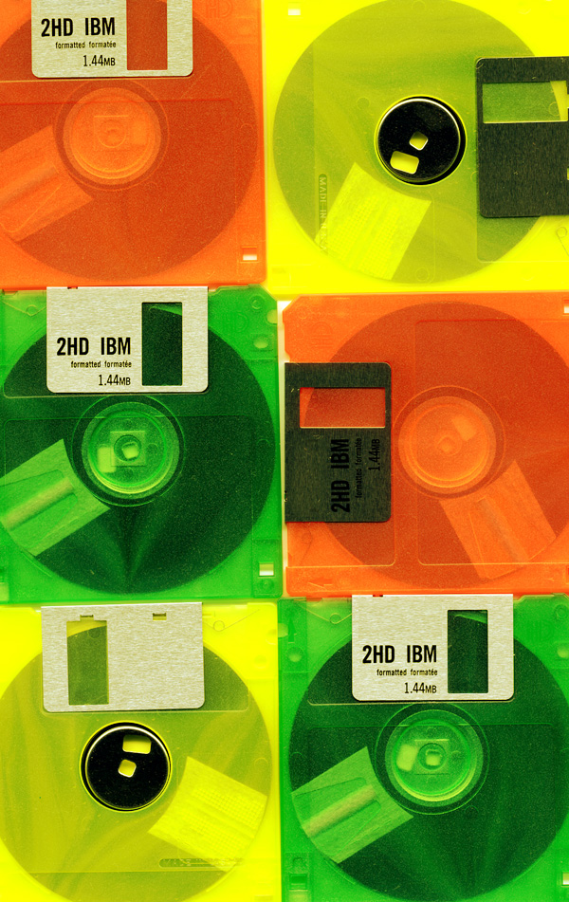
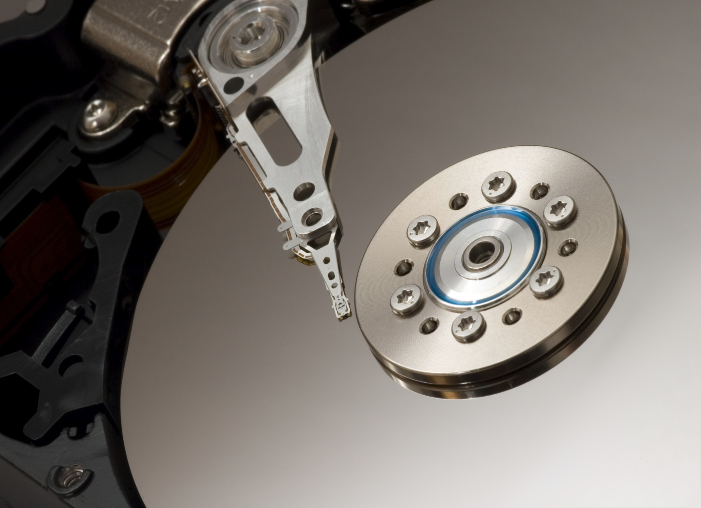
Magnetic storage
Notes:
Nonvolatile
Information isn’t lost when computer is turned off.
Many types – Depends on your needs
Most common form of storage
Hard drives, floppy drives, tape
All magnetic drives work the same

Slide 7
History
1956: IBM invented the first storage system; had 50 disks of 2 foot diameter!
The capacity …. 5 MB
Currently, we have hard disks of > 1.5 TB
?
Do we need more storage capacity
Parkinson’s law: Data expands to fill the space available for storage
\
Corollary: Work expands to fill the time available.
Notes:
The hard disk drive has short and fascinating history. In 24 years it evolved from a monstrosity with fifty two-foot diameter disks holding five MBytes (5,000,000 bytes) of data to today's drives measuring 3 /12 inches wide and an inch high (and smaller) holding 400 GBytes (400,000,000,000 bytes/characters). Here, then, is the short history of this marvelous device. (http://www.duxcw.com/digest/guides/hd/hd2.htm)
n 1956 IBM invented the first computer disk storage system, the 305 RAMAC (Random Access Method of Accounting and Control). This system could store five MBytes. It had fifty, 24-inch diameter disks!
In 1980, Seagate Technology introduced the first hard disk drive for microcomputers, the ST506. It was a full height (twice as high as most current 5 1/4" drives) 5 1/4" drive, with a stepper motor, and held 5 Mbytes.

Slide 8
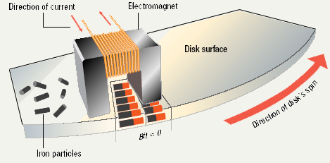
How they function:
Notes:
Data storage and retrieval
Media is covered with iron oxide
Read/write head is a magnet
Magnet writes charges on the media
Positive charge is a 1
Negative charge is a 0
Magnet reads charges
Drive converts charges into binary

Slide 9
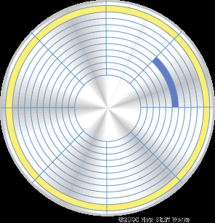
Sector
Track
Photo credits: www.howstuffworks.com
Notes:
Data organization
Disks must be formatted before use
Format draws tracks on the disk
Tracks is divided into sectors
Amount of data a drive can read
Tracks, cylinders
Sectors, clusters
Platter

Slide 10
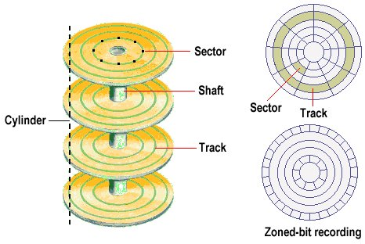
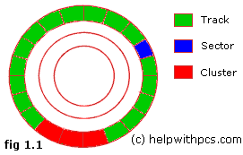
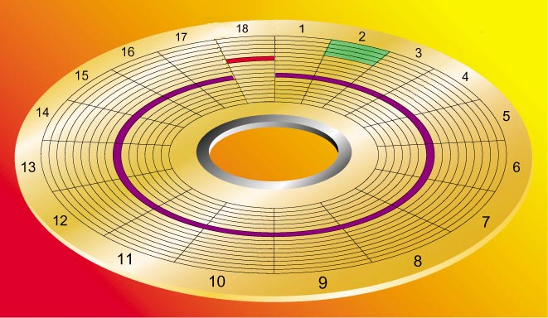

Slide 11
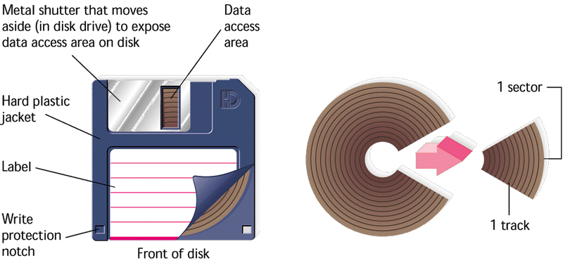
Floppy drive:
Notes:
Mylar plastic
Easily damaged
Diskettes
Also known as floppy disks
Read with a disk drive
Mylar disk
Spin at 300 RPM
Takes .2 second to find data
3 ½ floppy disk holds 1.44 MB
Zip disk: 100 MB or 250 MB = 170 floppies
Iomega™
Need a special drive
Superdisk: 120 MB
Laptops
Imation™
Hi FD Disks: 200 MB
Sony
Can read a 1.44 floppy

Slide 12
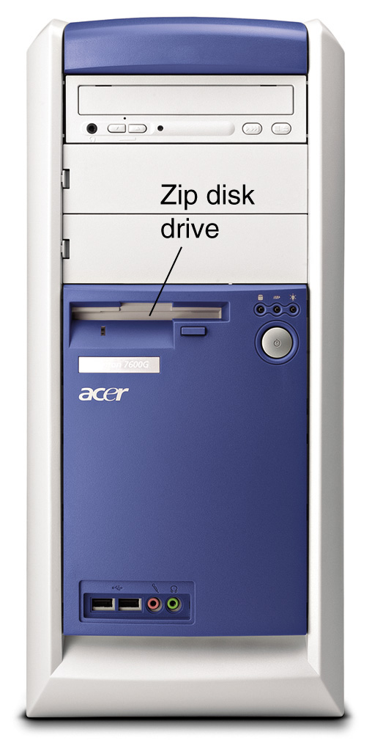
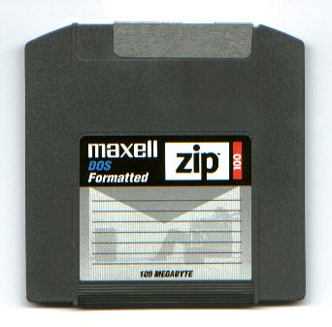
Floppy drive
spins at 300 RPM;
takes .2 second to find data;
holds up to 1.44 MB data
ZIP disk is an example
high-capacity floppy disk
(~100 MB)

Slide 13
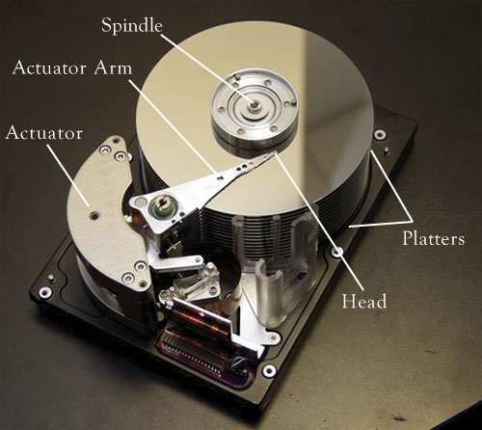
Hard disk:
Photo credits: http://preview.tinyurl.com/6aj52l
Notes:
Thick and rigid; Large capacity; High speed; Magnetic
Use Metal Platters; Each platter has 2 sides
Sensitive (Hard disk crash) You can lose data!
Primary storage device in a computer
Spin between 5,400 to 15,000 RPM
Data found in 9.5 ms or less
Drive capacity usually greater than 40 GB

Slide 14
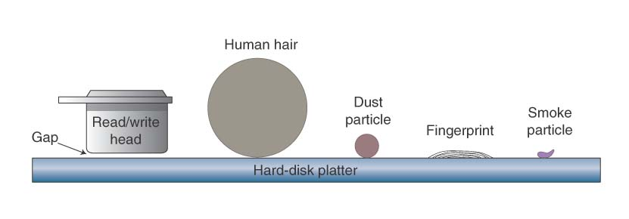
Hard disk drive
spins at 5400, 7200, 10000, 15000 RPM;
takes 6 to 12 milliseconds to find data;
holds up to 1.5 TB data
Most commonly used storage media

Slide 15
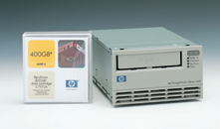
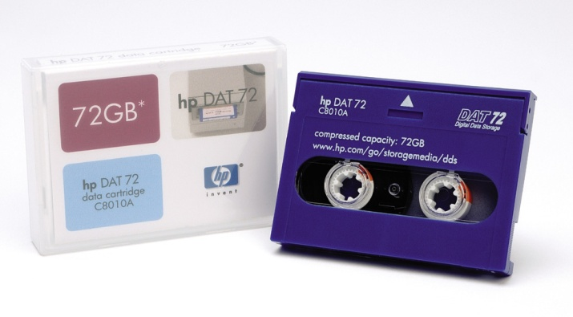
Tape drive:
Sequential access (not random)
Can store very large amounts of data
Commonly used for:
Backups
Infrequently used data
Notes:
Backup files on a tape cartridge
Must be accessed sequentially from beginning to end. To illustrate, compare the modern audio CD to the antiquated 8-track. On a CD if you wish to hear song 1 over and over, you simply press repeat. In an 8-track, you often must play the entire tape before the song can be repeated.

Slide 16
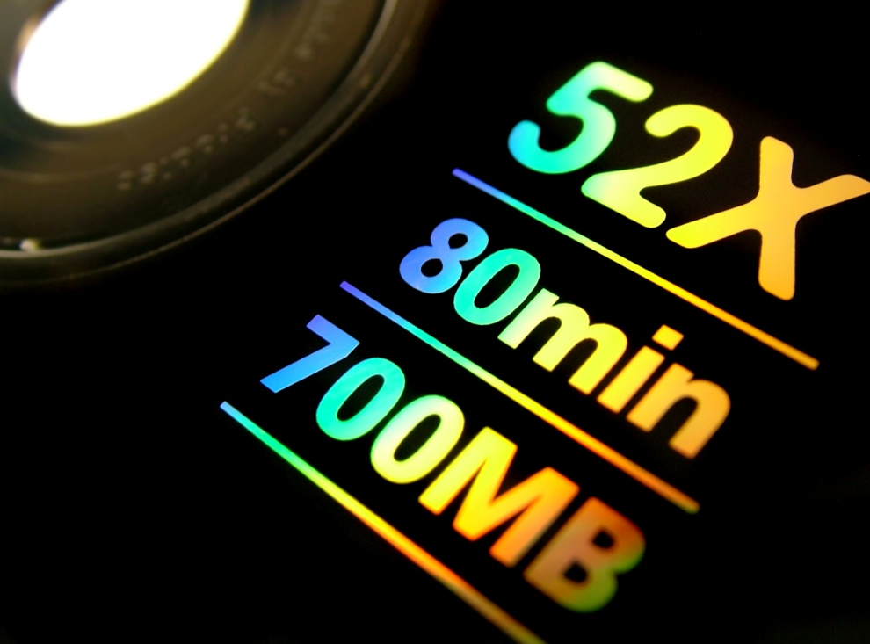

Optical storage

Slide 17
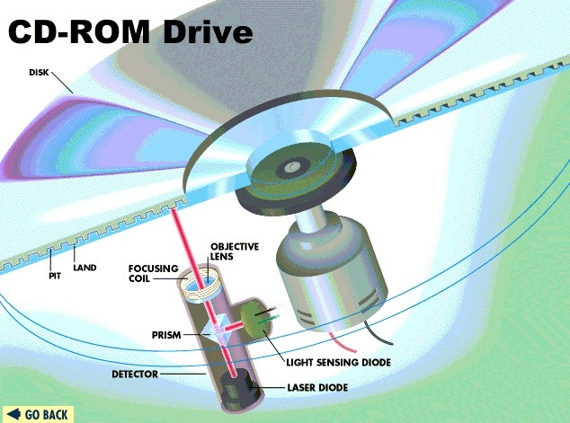
How they function:
Lands (1s) reflect data; Pits (binary 0s) scatter data
Notes:
Optical Disks: CD and DVD
Uses reflected light
Data is read by lasers
Size varies – 3.5” to 14”
4” X 4” is the most common
Rotation speed is important
24X speed accesses 3.6 MB per second

Slide 18
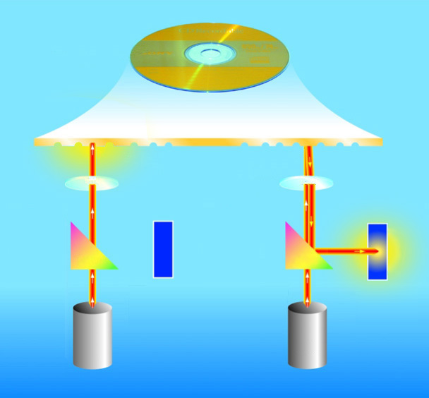
Compact disc label
pit
land
lens
lens
0
1
prism
prism
Light-sensing diode
Light-sensing diode
laser diode
laser diode

Slide 19
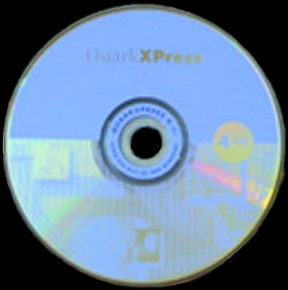
Read only optical drives:
CD-ROM (Capacity: 650 MB)
CD speed is based on the original CD speed (150 kbps); 10 X will read 1,500 Kbps
DVD-ROM (Capacity up to 18 GB)
Use both sides of the disk; can read CD-ROMs

Slide 20
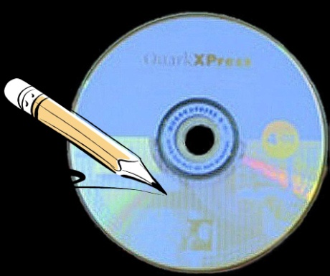
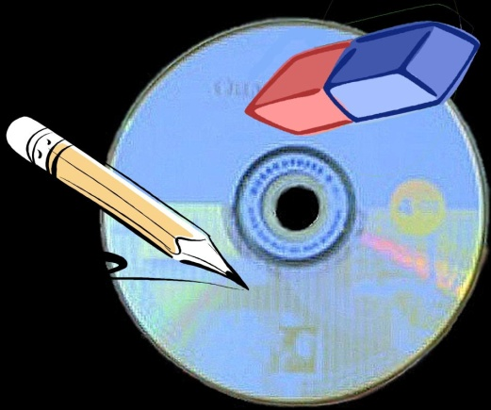
Recordable optical drives:
CD-R (Capacity: 650/700 MB)
Can record once; cannot be changed
Can keep adding until disk full
CD-RW (Capacity up to 650/700 MB)
Can record and can rewrite too (upto 100 times)
Cannot be read in all CD players

Slide 21
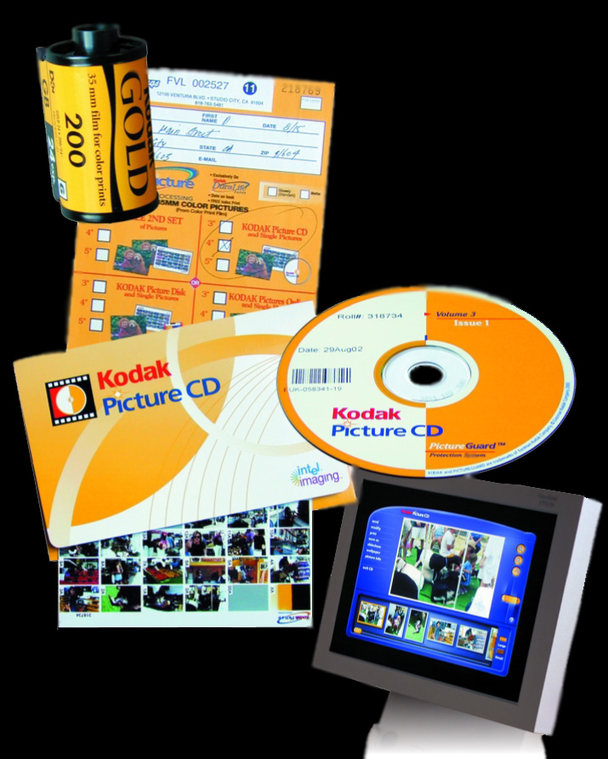
Recordable optical drives:
Photo-CD (developed by Kodak)
Photo storage;
Add until disk is full
(like CD-R)
Original pictures
cannot be changed

Slide 22
Recordable optical drives:
DVD-R (Capacity: 4.7/ 8.5 GB)
Several formats; none standardized
Cannot be read in all players
DVD-RAM
Allows reusing DVD media; Not standardized; Easily writable
Cannot be read in all players

Slide 23

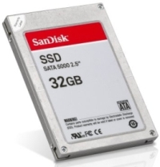
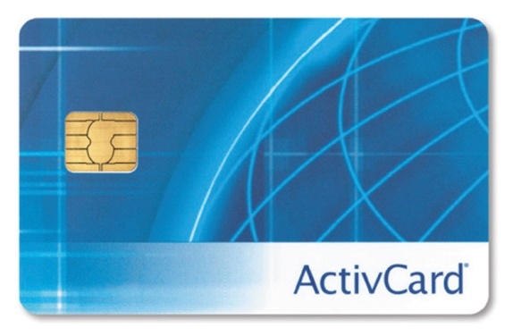
Solid-state storage
Notes:
Data is stored physically
No magnets or laser
Very fast

Slide 24
How they function:
A solid-state drive (SSD) is a data storage device that uses solid-state memory to store persistent data.
An SSD using SRAM or DRAM (instead of flash memory) is often called a RAM-drive.
No moving parts
(unlike magnetic/ optical storage)
Notes:
No moving parts
Costly
“Flash” memory for laptops, cameras, MP3.
Lower read time --- they are much faster than hard drives.
For more details, study http://en.wikipedia.org/wiki/Solid_state_disk

Slide 25
Flash memory:
Found in cameras and USB drives
Combination of RAM and ROM
Long term updateable storage
Notes:
No moving parts
Costly
“Flash” memory for laptops, cameras, MP3.

Slide 26
Smart card:
Credit cards with a chip
Chip stores data
May be used as electronic cash
Hotels use for electronic keys
Notes:
No moving parts
Costly
“Flash” memory for laptops, cameras, MP3.

Slide 27
Solid State Disks (SSD):
Large amount of SDRAM
Extremely fast
Volatile storage
Require battery backups
Most have hard disks copying data
Notes:
No moving parts
Costly
“Flash” memory for laptops, cameras, MP3.

Slide 28
Performance comparison

Slide 29
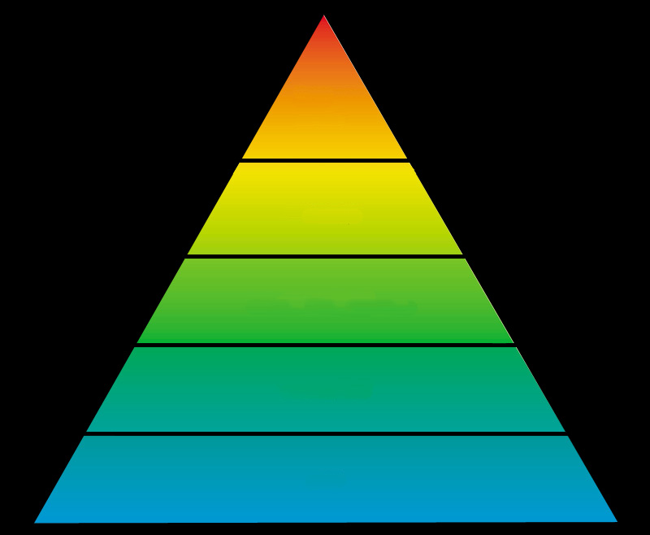
Storage hierarchy
more expensive
faster
RAM
Hard Disk
cost
speed
Compact Disc
less expensive
slower
Floppy Disk
Tape
Notes:
A ranking of computer memory devices, with devices having the fastest access time at the top of the hierarchy, and devices with slower access times but larger capacity and lower cost at lower levels.
The hierarchical arrangement of storage in current computer architectures is called the memory hierarchy. It is designed to take advantage of memory locality in computer programs. Each level of the hierarchy has the properties of higher bandwidth, smaller size, and lower latency than lower levels. Most modern CPUs are so fast that for most program workloads, the locality of reference of memory accesses and the efficiency of the caching and memory transfer between different levels of the hierarchy are the practical limitation on processing speed. As a result, the CPU spends much of its time idling, waiting for memory I/O to complete.
The levels of memory in a computer. From fastest to slowest speed, they are:
Processor registers – fastest possible access (usually 1 CPU cycle), only hundreds of bytes in size
Level 1 (L1) cache – often accessed in just a few cycles, usually tens of kilobytes
Level 2 (L2) cache – higher latency than L1 by 2 to 10 times, often 512 KB or more
Main memory – may take hundreds of cycles, but can be multiple gigabytes.
Secondary and Tertiary storage – several seconds latency, can be huge

Slide 30
Average access time
Depends on 1) RPM, 2) time to access track
Hard disk: 6 to 12 ms; CD drive: 80 to 800 ms
In contrast, RAM access time is in nanoseconds
Transfer rate
Hard disk: 15 – 160 Mbps;
CD drive: base rate= 150 Kbps; 24x; 48x
Floppy disks: 45 Kbps

Slide 31
How is storage used by operating systems
?
?
?

Slide 32
Formatting
Disk formatting is the process of preparing a hard disk or other storage medium for use, including setting up an empty file system [Wikipedia].
2 levels of formatting:
Low-level: drawing tracks and sectors on disk
High-level: creating filesytem and bootsector (sometimes called quick or logical format)
Notes:
Each track and sector is labeled
Some are reserved
Listing of where files are stored
File Allocation Table (FAT)
FAT32
NTFS
Data is organized in clusters
Size of data the OS handles

Slide 33
File Systems
A file system is a logical method of configuring data on a disk’s surface.
Listing of where files are stored
Common file systems include:
File Allocation Table (FAT)
FAT32
NTFS
EXT2/EXT3 (Linux)

Slide 34

Optimizing computer performance
Notes:
Disk optimization
Handled by operating system tool
Routine disk maintenance
Optimization should be run monthly
Clean up unnecessary files
Delete temp files
Uninstall unused programs
Delete obsolete data files
Files should be cleaned weekly

Slide 35
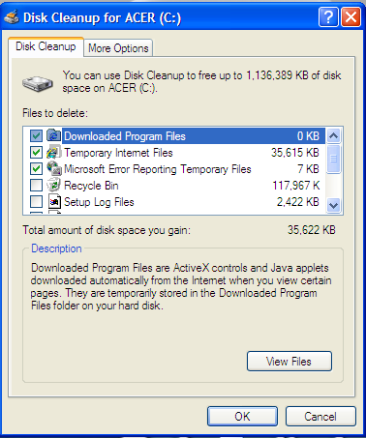
Deleting unneeded files
Notes:
Scan a disk for errors
Bad spots on the media
Find and fix the error
Move data to a good spot
Mark the spot as bad
Disks should be scanned monthly

Slide 36
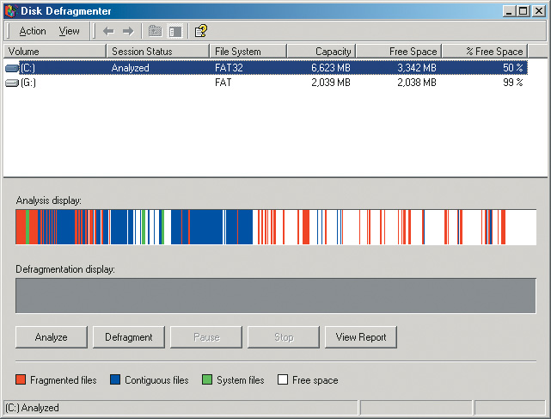
Disk defragmentation
Notes:
Defragment a disk
Files fragment when resaved
Fragmented files load slower
Defragment puts the fragments together
Disks should be defragged monthly

Slide 37
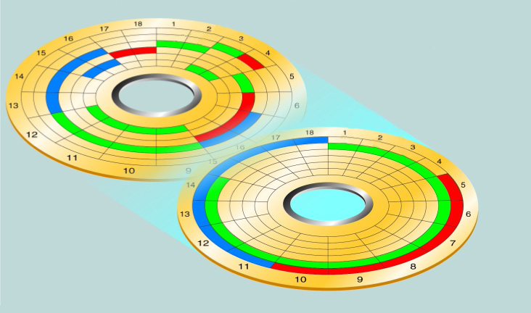
Disk defragmentation
file 1 after defragmenting
disk after defragmentation process

Slide 38
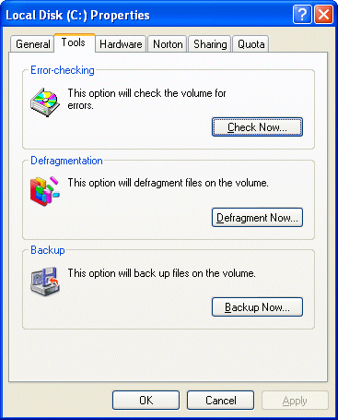
Scanning HDD for errors
Notes:
Scan a disk for errors
Bad spots on the media
Find and fix the error
Move data to a good spot
Mark the spot as bad
Disks should be scanned monthly

Slide 39
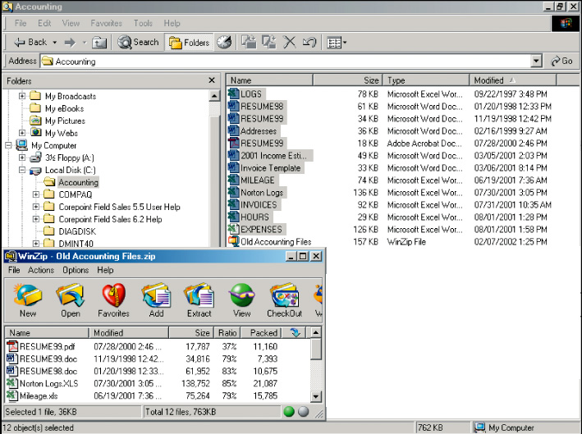
File compression
Notes:
File compression
Shrinks the size of a file
Takes up less space on disk
Reduce a disks performance
Will increase disk capacity
PKZip, WinZip and WinRAR
MP3s are created using compression. If a audio song is recorded on a hard drive, the required storage is about 1 MB per second. When the MP3 compression is applied, the size is reduced to about 1 MB per minute.
Windows XP provides several compression routines. It provides for .zip file compression and archive creation. Zip archives can be accessed like normal folders. Folders can be compressed to shrink the contents. Finally, the entire disk can be compressed .

Slide 40
Lecture’s
Summary
Hierarchy of memory/ storage devices
Magnetic storage:
Disk/ Tape/ Floppy drives
Optical storage:
Readable/ recordable
Solid-state storage:
Flash, Smart cards, Solid-state-disk
Optimizing computer performance

Slide 41

Lecture’s
References
for this week
“Storing Data’’ and
“Measuring and Improving disk performance’’
for next week
“Using Operating Systems” and
“Survey of PC and Network Operating System”

Slide 42
?
?
?
Questions/ Confusions?
Credits/ Acknowledgement can be found at the course website: http://tinyurl.com/5hb8pp

